Slide 1
EST 200 DESIGN AND ENGINEERING

Slide 2
Purpose of this course
introduce the undergraduate engineering students the fundamental principles of design engineering
make them understand the steps involved in the design process and
familiarize them with the basic tools used and approaches in design.

Slide 3
Assessment Pattern
Continuous Internal Evaluation (CIE) Pattern:
Attendance : 10 marks
Continuous Assessment Test (2 numbers) : 25 marks
Assignment/Quiz/Course project : 15 marks
End Semester Examination (ESE) Pattern: There will be two parts; Part A and Part B.
Part A : 30 marks
Part B : 70 marks
Part A contains 10 questions with 2 questions from each module, having 3 marks for each question.
Students should answer all questions.
Part B contains 2 case study questions from each module of which student should answer any one.
Each question carry 14 marks and can have maximum 2 sub questions.

Slide 4
Module 1
Design Process:- Introduction to Design and Engineering Design, Defining a Design Process-:Detailing Customer Requirements, Setting Design Objectives, Identifying Constraints, Establishing Functions, Generating Design Alternatives and Choosing a Design.

Slide 5
Introduction to Design and Engineering
Design
It is the plan for the construction of object/system/implementation of an activity.
Output of design can be called as a prototype (early sample/release of a product build to test a concept)
Why do we design?
To meet a need.
To find a solution

Slide 6
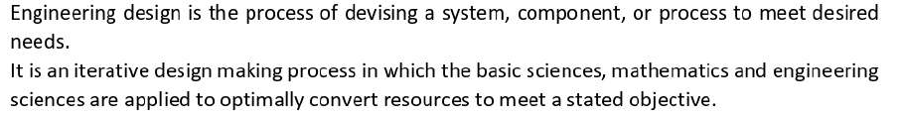
Engineering design
Solution /output can be
Product
Technique
Structure
Project
Method etc..
Eg:-Architectural blueprints ,engg drawing, circuit diagrams etc

Slide 7
Contd..
The fundamental elements of the design process is the establishment of objectives and criteria, synthesis, analysis, construction, testing and evaluation
The general procedure for completing a good engineering design can be called the Engineering Method of Creative Problem Solving.
Problem solving is the process of determining the best possible action to take in a given situation.

Slide 8
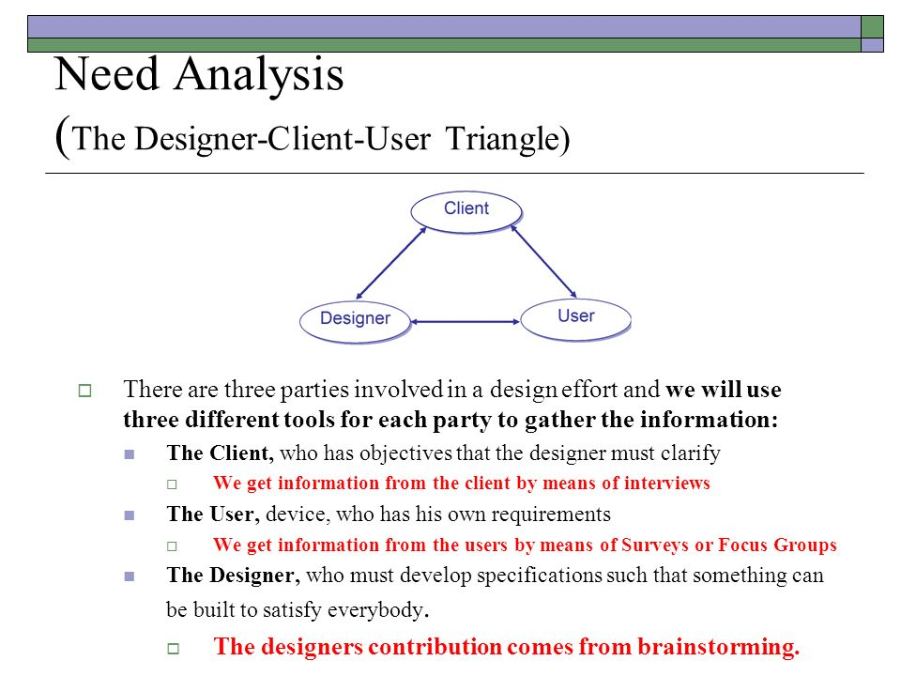
Where/for whom do engineers design?

Slide 9
Persons related to a new design
Client-a person or group or company that wants a design conceived
Designer-whose job is to solve the client’s problem
User- a person who employ or operate whatever is being designed
The designer has to understand what both the client and the users want and need

Slide 10
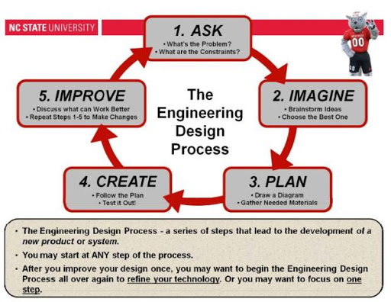
Design Process

Slide 11
Design levels
As in any field of human activity, there are different degrees of difficulty.
Based on the difficulty of the design process, it can be classified into three types:
Adaptive design
Development design
New design

Slide 12
Adaptive Design
It is usually the most easiest types of a design process.
It deals with creation of a design process based on an existing similar process.
Since the resources are readily available, adaptive designs could be performed in a short period of time. That is, the existing design can be adopted for new design with some modifications.
Example: Design process for an elevator has been technically and conceptually the same for a long period of time. Hence, the problems related to its design could be solved by a designer with an ordinary technical training.

Slide 13
2. Development Design
A development design is considerably complex in nature.
The designer may start from an existing design, but the final outcome may vary significantly from the initial product
Example: Design of a continuous variable transmission system (CVT) is developed from a manual gear box transmission type. Hence, a development design process requires a considerable amount of scientific training as well as a better designing ability.

Slide 14
3. New design
A new design often attributes to the creativity of the designer.
It is not inherited from any of the existing designs.
This is possibly the most difficult design process as generating a new concept involves mastering design and engineering knowledge, in addition to creativity and imagination.
Some common new designs include the initial development of computers, cars, flights, engines etc.
Any product which is the first of its kind may be regarded as an outcome of a new design process

Slide 15
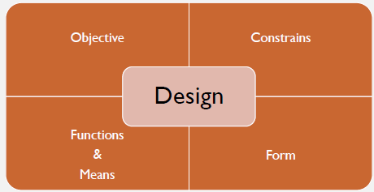
ASPECTS OF DESIGN
DESIGN OBJECTIVES
DESIGN CONSTRAINTS
DESIGN FUNCTIONS
DESIGN MEANS
DESIGN FORM

Slide 16
1. Design Objectives
A feature or behaviour that we wish the design to have or exhibit.
Some generic objectives are
To identify the need of the user
To reduce the cost
To reduce the complexity
To make eco-friendly material

Slide 17

EXAMPLE: OBJECTIVE OF A PORTABLE LADDER
Ladder should be compact and portable
It should be stable on smooth surfaces
Should stand safely without a support
Can be used for house hold requirements
Should be reasonably stiff and comfortable for users
Must be safe and durable
Should be relatively economical
Should be reduce space requirements while packing by means of detachable parts
The ladder should be marketable

Slide 18
2. Design Constraints
A limit or restriction on the features or behaviors of the design. A proposed design is unacceptable if these limits are violated.
Example:
a) Functional Constraints
- Overall geometry
- Energy requirement
- Materials used
- Control systems
b) Safety constraints
c) Quality constraints
d) Time constraints

Slide 19
3. Design Functions
Functions are the behaviors that expected from the design.
A design should perform certain functions to convert given input to the required output.
They describe what the design (or, more likely, an object within the design) will do or accomplish, with an emphasis on input-output transformations.
The statement of a function typically couples an action verb to a noun or object:
Eg: lift a book, support a shelf, transmit a current, measure a temperature, or switch on a light

Slide 20
4. Design Means
It is the way in which a design executes a desired function.
•Eg: The function of a bicycle brake is stop the wheel when applying the brake lever by means of frictional force between rim and brake pad.
Eg: The function of a speaker is to produce sound by means of electro magnetic induction
5. Design Form
The shape and structure
An area or mass to define objects in space
Two dimensional
Three dimensional

Slide 21
How Engineering Design is different from other kinds of design
Scientists study how nature works, Engineers create new things, such as products, websites, environments, and experiences.
Scientists perform experiments using the scientific method; whereas, Engineers follow the creativity-based engineering design process. The kinds of design involve.
Engineering Design that applies to engineered structures, infrastructure, technology and machines in creating functional products and processes.
Engineering design is the creative process of identifying needs and then devising a solution to fill those needs. This solution may be a product, a technique, a structure, a project, a method, or many other things depending on the problem. It is a decision – making process (Often iterative), in which the basic sciences, mathematics and engineering sciences are applied to optimally convert resources to meet a stated objective.

Slide 22
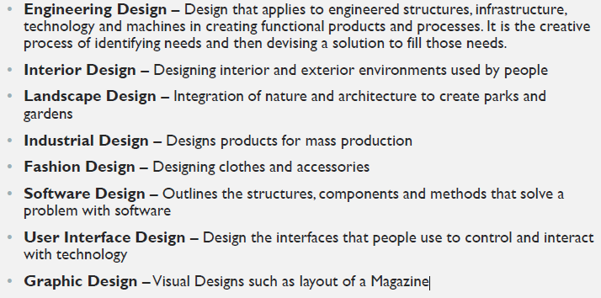

Slide 23
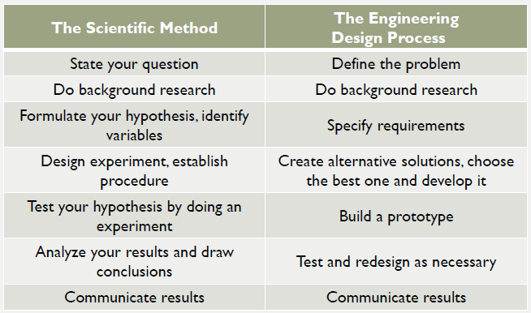

Slide 24
Where and When do Engineers Design?
Engineering designers work in many different kinds of environments: small and large companies, start-up ventures, government, not-for profit organizations, and engineering services firms.
An engineer working for a large company that processes and distributes various food products could be asked to design a container for a new juice product.
Engineer could work for a design-and-construction company, designing part of a highway bridge embedded in a larger transportation project.
for an automobile company that is developing new instrumentation clusters for its cars.
for a school system that wants to design specialized facilities to better serve students with orthopedic disabilities

Slide 25
Different Roles played as the design unfolds:
Client: a person or group or company that wants a design conceived.
The client could be internal (e.g., a person at the food company in charge of the new juice product) or external (e.g., the government agency that contracts for the new highway system).
User: someone who will employ or operate whatever is being designed.
the users are the consumers who buy and drink a new juice drink, and drivers on a new interstate highway.
Users have a stake in the design process because designs have to meet their needs.
Designer: someone whose job is to solve the client’s problem in a way that meets the user’s needs.

Slide 26
Basic Vocabulary in Engineering Design
Accuracy:The quality of being near to the true or desired value
Analysis: Breaking an object or process into smaller parts to examine or evaluate systematically
Assessment: An evaluation of the cost, quality and/or ability of someone or something
Communicate: To share information orally, in written form and/or graphically through various forms of media.
Constraints: A limitation or condition that must be satisfied by a design, including materials, cost, size, labor, etc.
Criteria: Attributes of a design that can be measured; a set of standards upon which a decision is based
Design: To generate or to propose a possible solution; to create, fashion, execute, or construct
Diagram: A visual representation of data or information

Slide 27
Effectiveness: A determination of how well a solution meets the criteria
Efficiency: The measurable relationship between a solution and the amount of resources it requires
Error: The difference between a measured value and its true or accepted value; important
Failure: The inability of a device, process, or system to perform a required function
Function: A specific task that a system or part of a system performs or is intended to perform
Limit : The minimum or maximum permissible value
Model : A diagram, replica, mathematical representation, analogy, or computer simulation used to analyze a system for condition flaws, test a solution, visualize or refine a design, and/or communicate design features

Slide 28
• Observation : To become aware of an occurrence using the senses
Plan (n.) : A systematic approach to solving a problem
Problem : A situation to be changed; a question raised for inquiry, consideration, or solution
Process : A series of steps that form a pathway to a solution
Prototype : A model that tests design performance

Slide 29
How to learn and do Engineering Design
Design problems are ill structured (no structured / formulaic solution) and open ended (many acceptable solutions possible) which makes Engineering Design not easy.
Their solutions cannot normally be found by applying mathematical formulas or algorithms in a routine or structured way.
Teaching how to do engineering design is not easy. It is learned by doing(studio aspect).

Slide 30
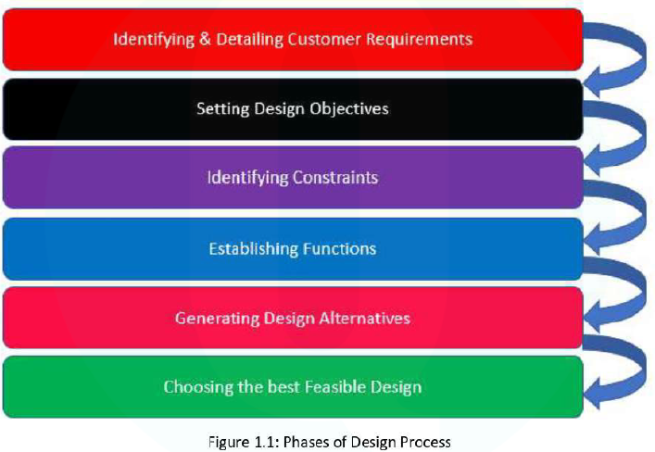
Defining a Design Process

Slide 37
Case Study 1: Wrist Watch
Problem: Show the designing of a wrist watch going through the various stages of the design process. Use hand sketches to illustrate the processes.

Slide 41
Case Study 2: Carry Bag

